Slide 1
“MEMBERSHIP”
Chamber Basics August, 2024
Brett Finley, President/CEO
North San Antonio Chamber

Slide 2
Do Memberships Drive Success?
Or Does Success Drive Membership?
DECLINING?
MATERIALS OLD?
TIME IS MONEY!
Sources: Dr. Glenn Freedman, Frank Kenny, Holman Brothers, Various Chambers

Slide 3
THE PERFECT MEMBER MAKE-UP
‣ The Member Pays Their Dues and Doesn’t Question The Amount
‣ The Member Sponsor Everything and Pay Their Invoice on time!
‣ The Member Serves on the Board and offer up Committee Members
‣ The Member supports YOU because it’s the RIGHT THING TO DO!
How Many Perfect Members Do You Have?

Slide 4
TOP 10 THINGS YOU NEED TO KNOW ABOUT MEMBERSHIP

Slide 5
#1 - Chamber Management Software
‣ Own it! Each member “profile” needs to be top notch. Gives value.
‣ Search Engine Optimization SEO
‣ Most referrals possible system
‣ Statistics Report

Slide 6
#2 - Monitor Membership Dues Totals
‣ What is the total dollar amount? Monthly? Annually? Budget? Goal?
‣ Chart the progress on daily basis - You need to know if you’re improving!
‣ Keep running total of new, reinstates, drops, renewals, etc.
Always know the total number of members you have.

Slide 7
#3 - Easy Online Process to Join
How easy is it to join your Chamber? At 2 a.m.? Is your website mobile friendly?

Slide 8
#4 - Do a New Member Orientation
‣ Know your packet? Is it up to date? Is it digital? Is it online?
‣ What’s your process of onboarding a member?
‣ Online or in person orientation sessions?
Discussion New Member Orientation Ideas …

Slide 9
#5 - Do The Ribbon Cutting of Today
‣ Quick and orderly (20-minutes) - Press Release
‣ Photos and videos? Live on Facebook? Uploading to Social Media?
‣ Level up if they want to pay more
‣ Set policy to level out the playing field. Specific times 10 am or 2 pm
$50 at basic level. Start ribbon cuttings at second tier

Slide 10
#6 - Utilize Your Ambassadors
‣ Build a Referral Camp - Utilize your Board, Current Members, Ambassadors, Volunteers - Incentivize them?
‣ 12 Most Wanted List
‣ Membership Events/Drives
‣ Monthly meetings to review

Slide 11
#7 - Know Your Market Penetration
‣ How many businesses are in your community?
‣ How many sales tax reporting outlets in your community?
‣ How many Certificate of occupancies from the City?
Penetration Rate =
(Number of Members ÷ Target Market Size) × 100

Slide 12
#8 - Know Your Membership Levels
‣ Know your categories
‣ Know what each member receives
‣ Review each year; Put before a focus group if needed
‣ Set your goals. Raise the bar.
Sample Here

Slide 13
#9 - R’s - Retaining & Reinstating Members
What is your retention rate? By Year? By Month?
It costs less to retain a member than to recruit one.
Number of members at end of year (2021): 3000​
Number of new members in (2022): 75​
Number of drops in (2022): 175 (do not include in calculations)​
Number at end of year 2022: 2,750​
​
Formula: 2,750 – 75 = 2,675 (end count – new members)​
2,675 (year end count) divided by 3,000 (beginning of year count) = ​
89% retention rate

Slide 14
#9 - R’s - Retaining & Reinstating Members (Cont’d)
‣ The most likely member to return is the one who most recently left. (Reinstate)
‣ What is Your Chamber doing with your Dropped Members?
Categories: Dropped, Uncontrollable, Dropped - Campaigns
‣ What is the timeframe for you? One year?

Slide 15
#10 - Engage Your Members
‣ A member that is engaged is a member that stays a member
‣ Member Touchpoints
‣ Volunteer Recruitment
‣ Scan in at events/Awards

Slide 16
WHY ARE THEY A MEMBER?
‣ P romotion
‣ L eadership Opportunities in Chamber, Community
‣ A dvocacy
‣ N etworking - Building Relationships
‣ E conomics - Business Growth
Also:
‣ Discounts and Savings
‣ Trainings/Masterclasses
‣ Information/Access to state/federal material
‣ Recognition/Awards
Shapiro Report - Being a Member of a Chamber = 80% increase in likelihood that consumers will patronize the business in the future.

Slide 17
Chambers of the Future
‣ Pay attention to the Young Professionals
‣ Automation in the Renewal Process will be key
‣ Collect payment immediate with credit cards
‣ Be able to virtually login to the office from anywhere
‣ Reach members who want to attend things virtually
‣ Events will be all about the “members’ experience”
‣ Member generations will want different things (i.e. Millennials - feel good, Gen Z - change/leadership)
– Text Polls, Virtual, Scans, etc.
Thoughts… Discussion…

Slide 18
MOST IMPORTANTLY…
Persistence & Planning Pays Off
Membership = Reason for Existence
Membership is Everyone’s Job!
If you are doing the right thing, it will show in your membership numbers! Be Patient. It will happen!

Slide 19
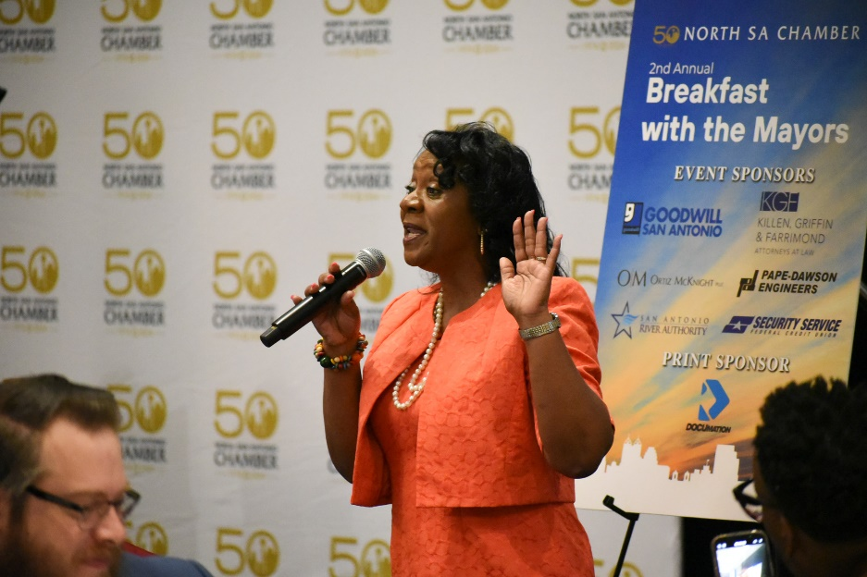
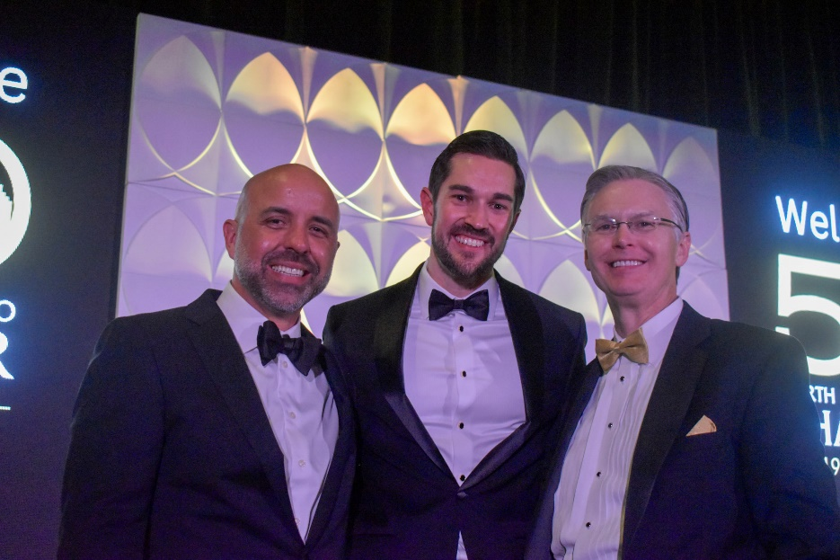
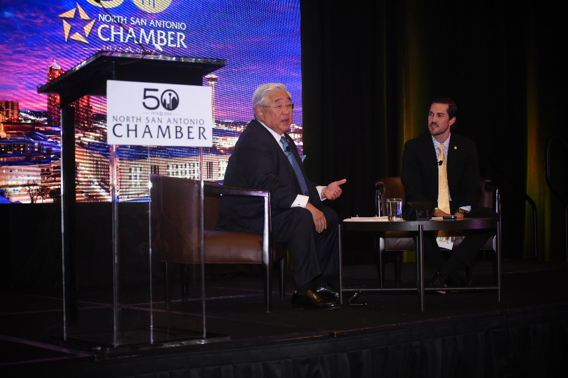
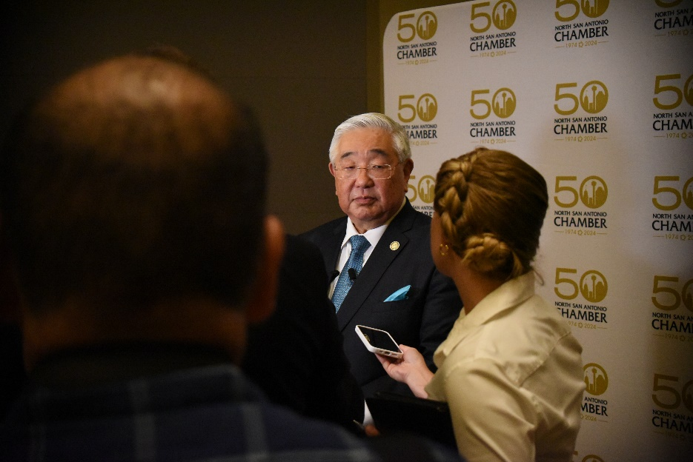
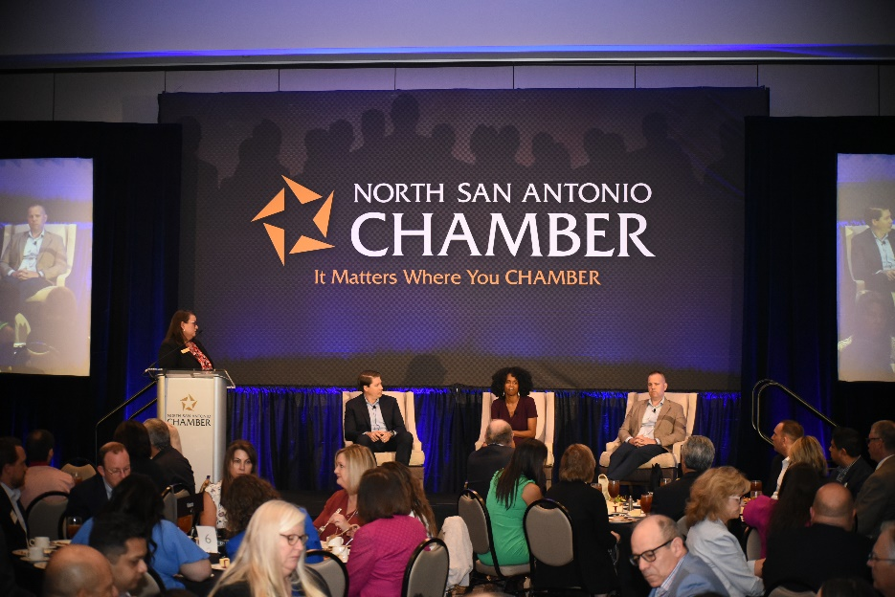
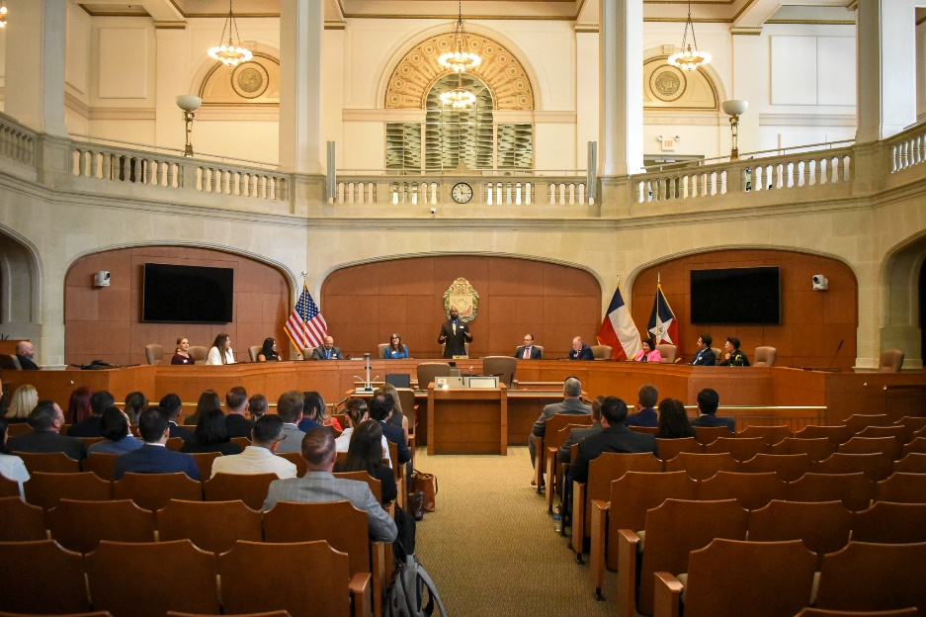
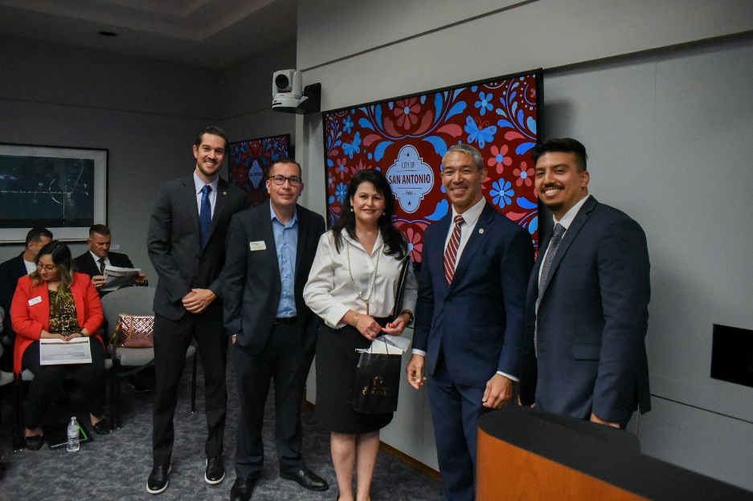
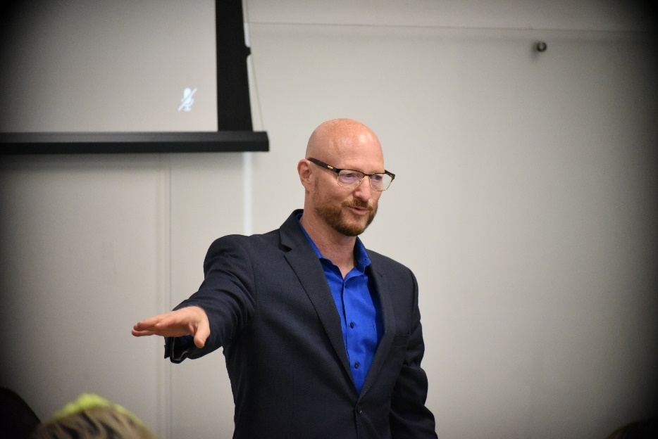
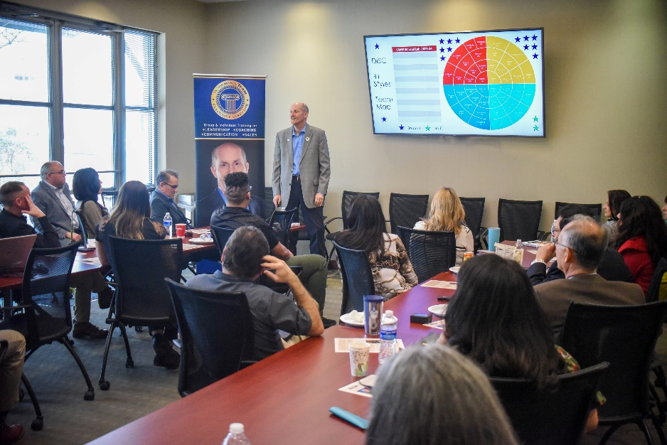

Slide 20
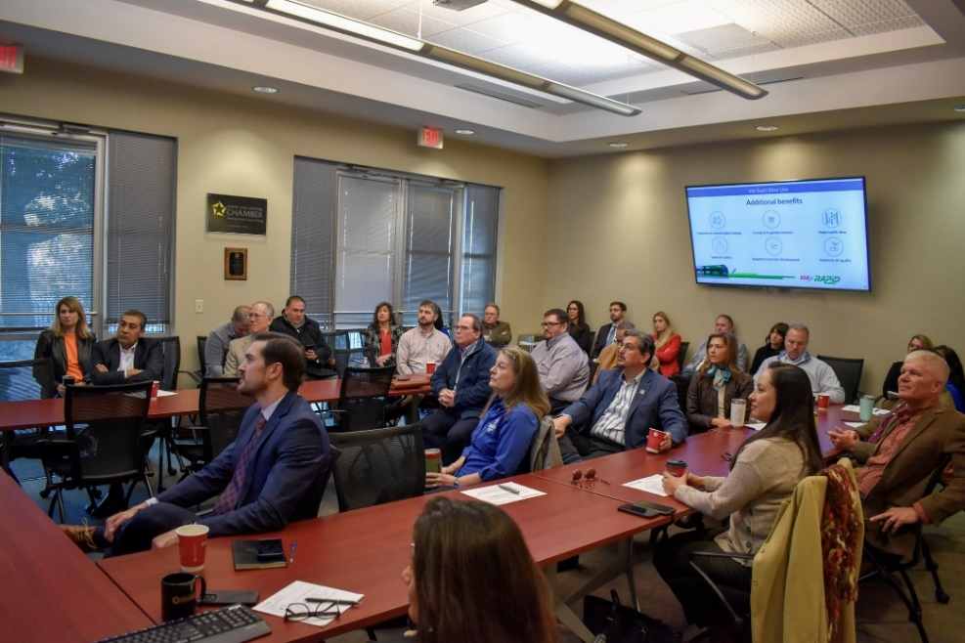
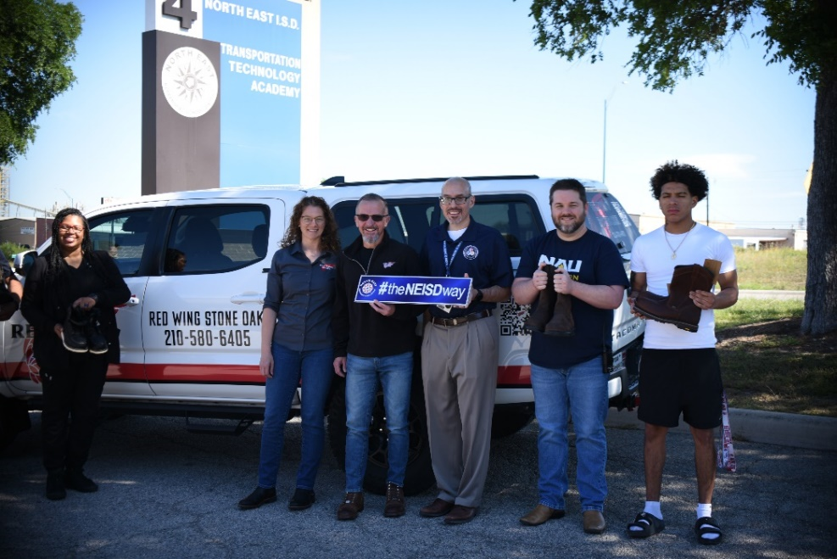
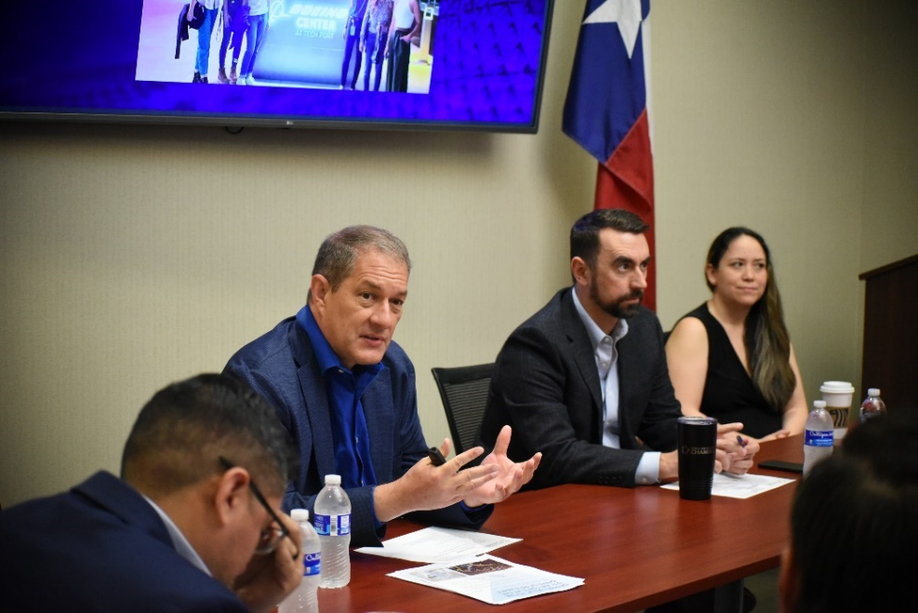
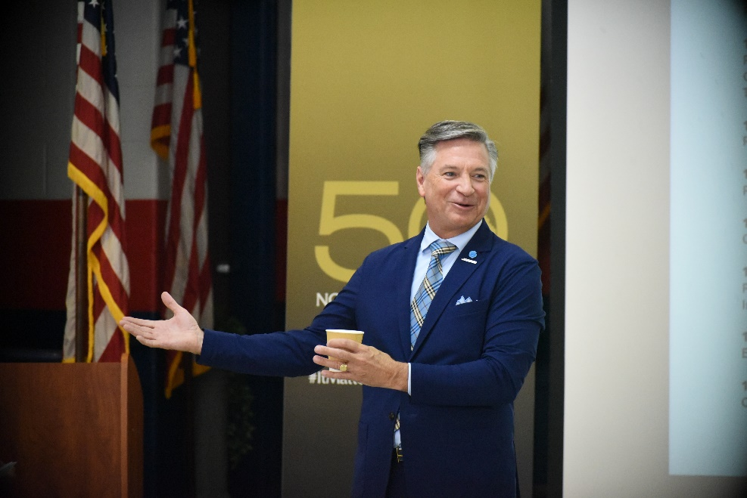
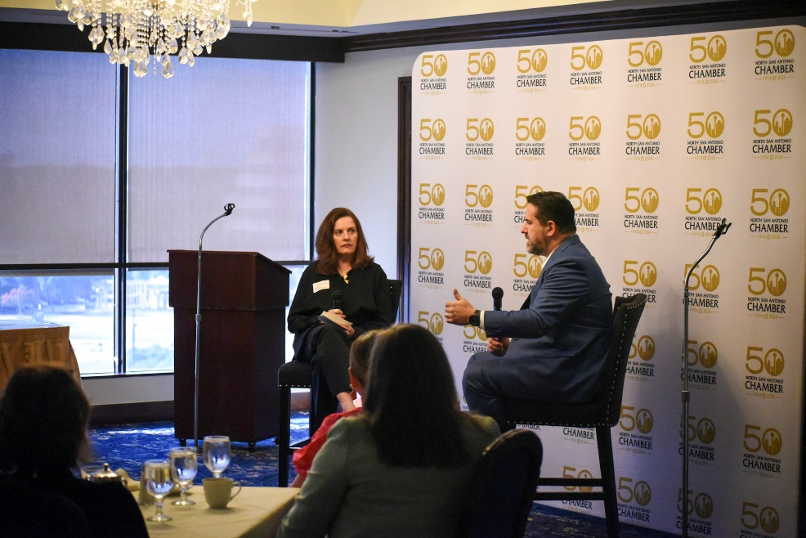
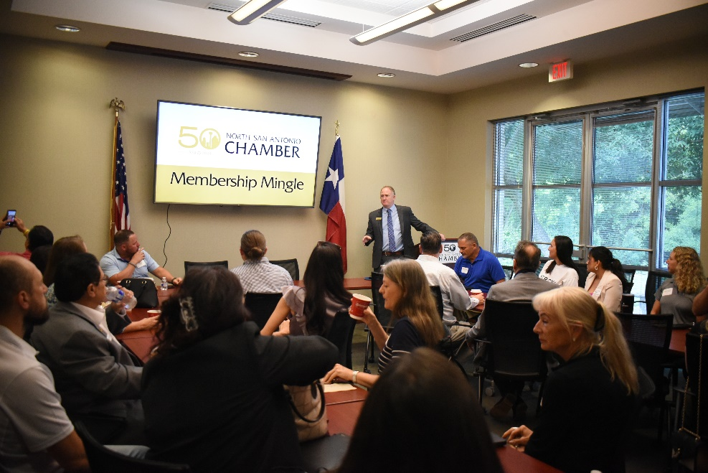
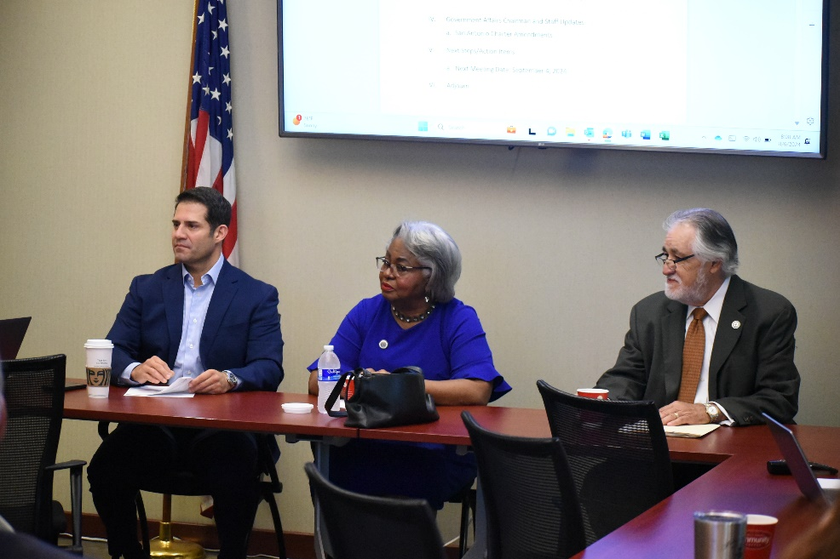
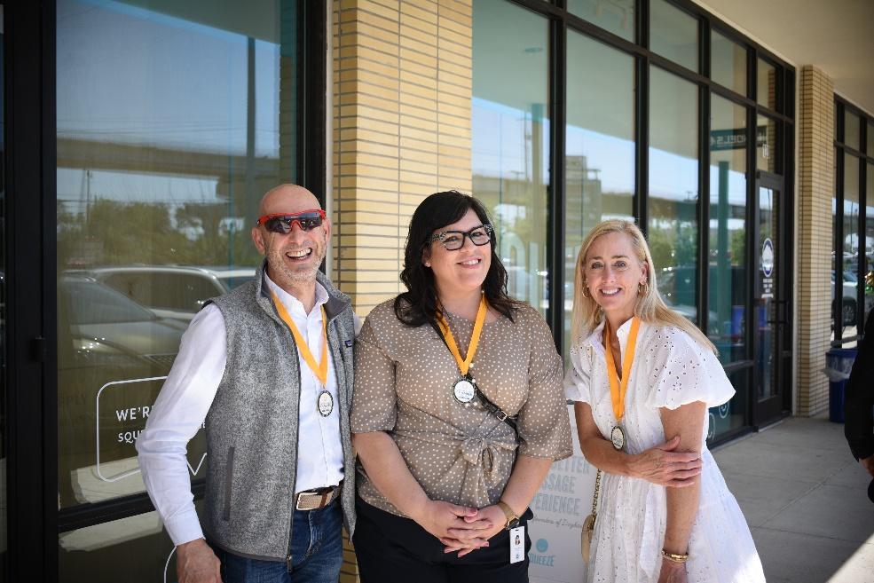
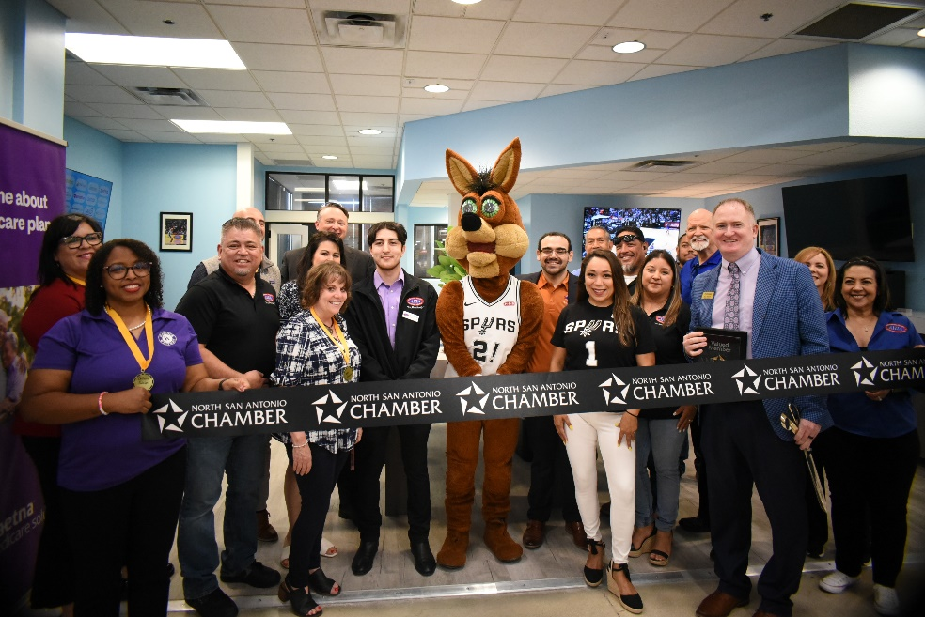
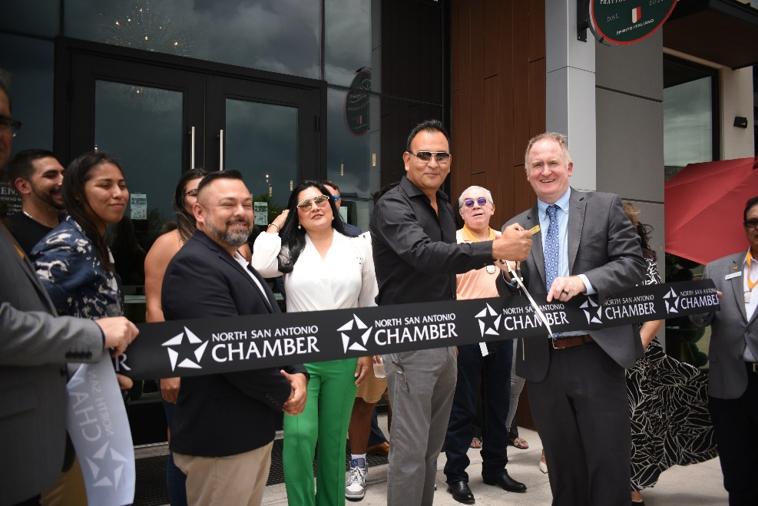
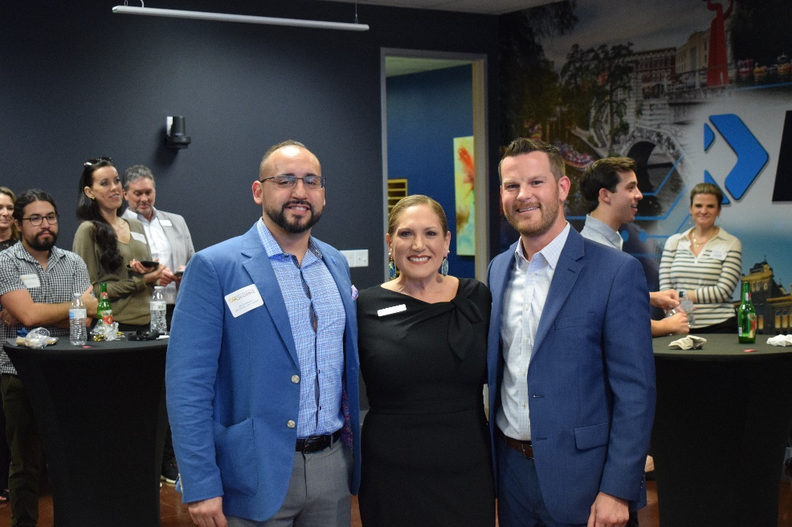

Slide 21
